Slide 1
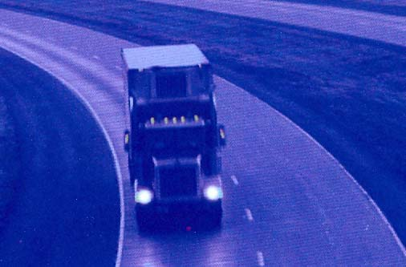
Introducing THE Brake Safe® ARROW logger™ Brake adjustment inspection System
Notes:
1

Slide 2
BRAKE SAFE® ARROW LOGGER™ is a visual, brake adjustment monitoring system showing brake stroke status during pre-trip and roadside inspection.
Identifies brakes that are out-of- adjustment or approaching the adjustment limit
Detects non-activating brake chambers
Identifies brakes that have failed to release
Indicates weak or broken parking brake springs
Shows the furthest point of brake stroke travel during repeated brake application.
Notes:
2

Slide 3
BRAKE SAFE® ARROW LOGGER ™ eliminates the number one fleet brake problem: OUT-OF-ADJUSTMENT BRAKES
OPERATION AIR BRAKE - SEPTEMBER 11-17, 2011 - CANADA & USA
OPERATION AIR BRAKE - SEPTEMBER 8-14, 2013 - CANADA & USA
OPERATION AIR BRAKE - SEPTEMBER 8-14, 2013 - CANADA & USA
Brake defects accounted for 59% of out-of-service violations.
Brake adjustment defects were the leading cause of brake related out-of -service violations (56% of all brake defects).
Vehicles equipped with Automatic slack adjusters accounted for 80% of out-of adjustment violations
Notes:
3

Slide 4
The Importance of Brake Adjustment
For braking safety, the DOT mandates a readjustment point commencing ½ inch before the manufacturer’s rated stroke is reached to ensure that effective braking will occur in both normal and emergency situations.
At the DOT readjustment point, brake force is approximately 3,000 lbs per wheel.
Beyond the readjustment point, brake force decreases significantly and at the manufacturer’s rated stroke limit, brake force is virtually non-existent.
Proper Brake Adjustment Means Shorter Stopping Distances

Slide 5
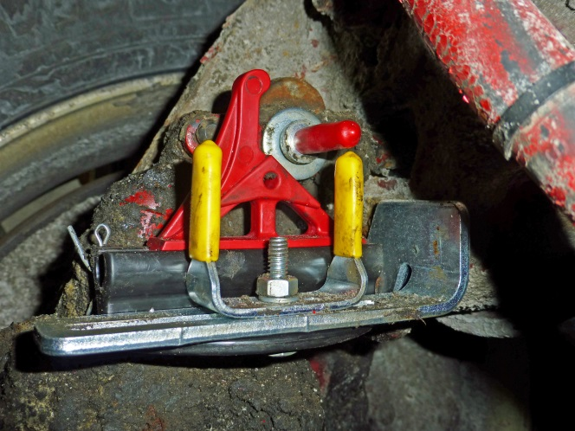
BRAKE SAFE® ARROW LOGGER™ Benefits
Reduced Maintenance Costs
Fewer unnecessary brake adjustments
Pre-empt costly repairs by identifying existing and potential brake repairs
Assists balanced braking
reducing uneven brake and
tire wear.
Notes:
5

Slide 6
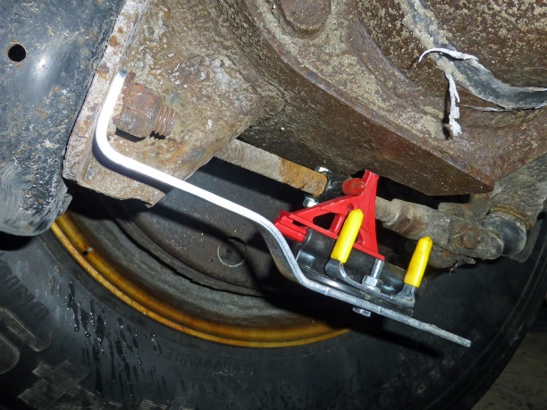
BRAKE SAFE® ARROW LOGGER™ Benefits
Improved Fleet Productivity
Less driver time on brake pre-trip inspection
Less downtime from out- of- service infractions
Reduced Preventative Maintenance time spent on foundation brake system
Equipment is on the road
quicker with less downtime
Notes:
6

Slide 7
BRAKE SAFE® ARROW LOGGER™ Benefits
Improved Fleet Safety
Ensure maximum braking capability in normal or emergency situations
Identify brake system defects before unsafe operation occurs
Inspect roadside brake adjustment without the need to apply the service brakes
Increase operator confidence in safety and reliability of fleet equipment
Demonstrate safety commitment to regulatory and inspection agencies
Notes:
7

Slide 8
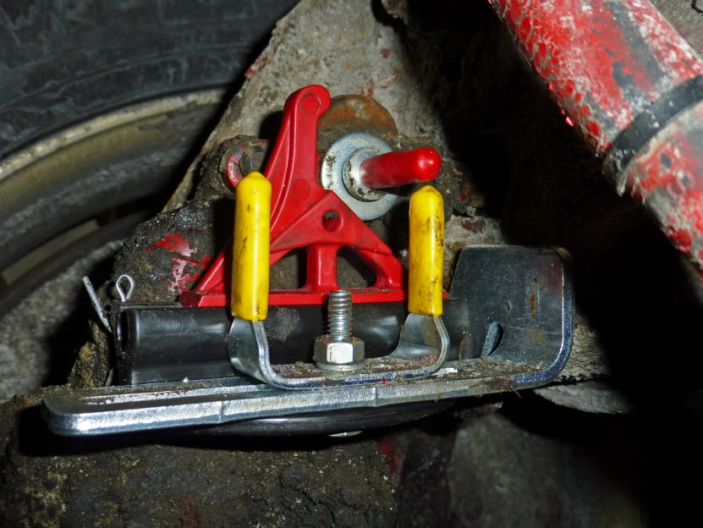
BRAKE SAFE® ARROW LOGGER™ Features
Brake adjustment status shown at each
wheel-end position.
Easy to see U-shaped
pre-measured indicator
unit (Goalpost) ensures
adjustment accuracy.
Raised Arrow clearly shows
brake re-adjustment point.
Raised Arrow
Indicator Unit
(Goalpost)
Notes:
8

Slide 9
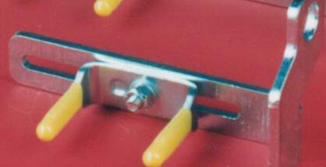
BRAKE SAFE® ARROW LOGGER™ Features
Brackets & Pre-measured Goalpost units are fabricated in “one piece” for superior strength
High quality steel fabrication with corrosion resistant zinc plating for extended operational life
Steel Fabrication Zinc Plating “One piece” indicator unit
Notes:
9

Slide 10
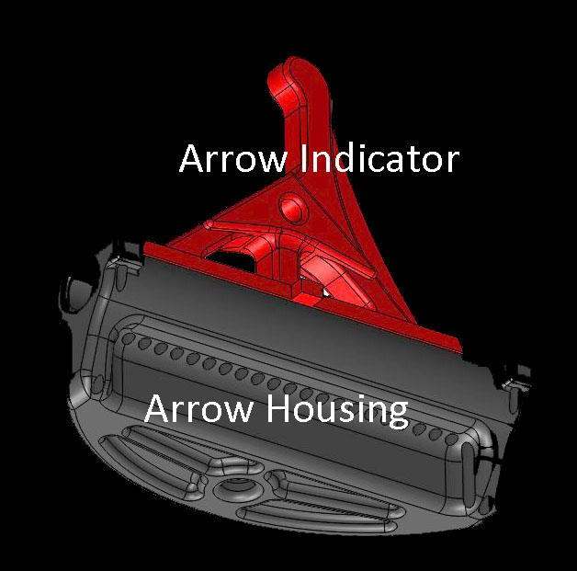
BRAKE SAFE® ARROW LOGGER™ Features
Logger Housing constructed
of self lubricating Acetal for
non-binding movement.
Logger Arrow Indicator is
manufactured from durable,
high impact nylon.

Slide 11
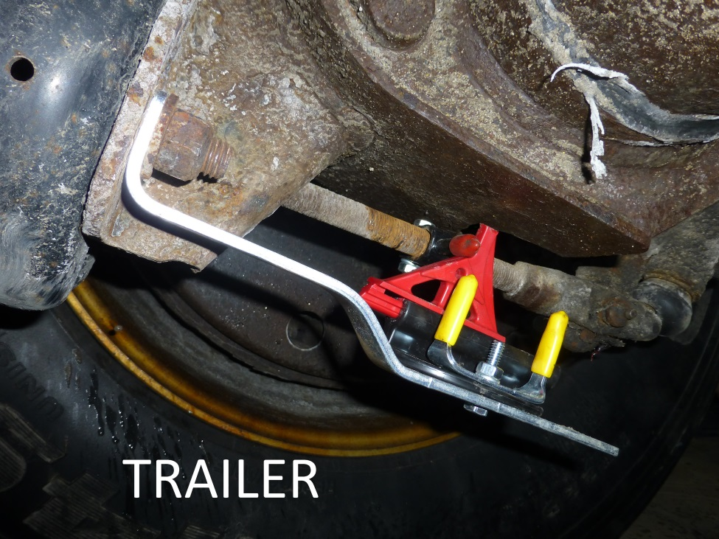
BRAKE SAFE® ARROW LOGGER™ Features
2 universal formats: one for trucks and one for trailers
Notes:
11

Slide 12
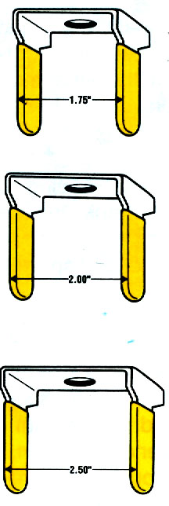
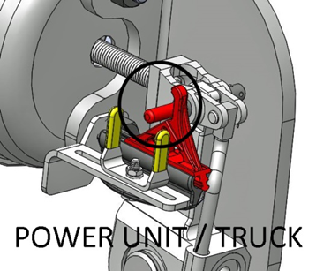
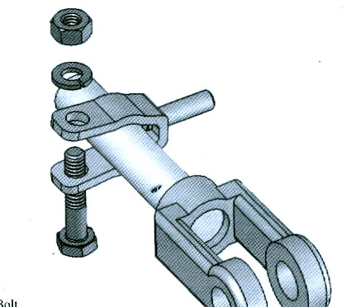
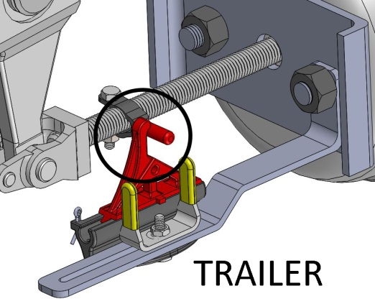
BRAKE SAFE® ARROW LOGGER™ Features
Pre-measured reference units (Goalpost) are set to re-adjustment point of 1.75”, 2.00” or 2.50”
Replacement clevis pin and clamp pin have tooled point for visibility and reliable contact with Arrow Indicator.
Notes:
12

Slide 13
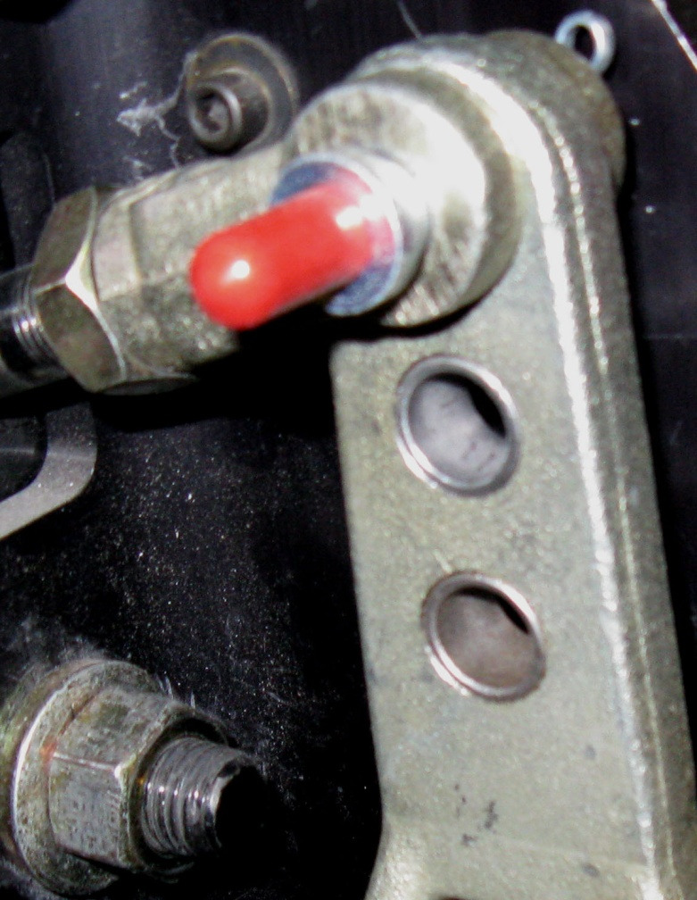
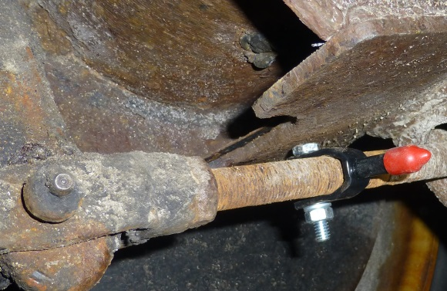
BRAKE SAFE® ARROW LOGGER™ HOW IT WORKS
A Brake Safe Logger™ tooled clevis
pin with the red pointer cover is inserted
into the slack adjuster yoke replacing
the existing clevis pin (Truck application).
A Brake Safe Logger™ clamp indicator
pin with the red pointer cover is attached
to the pushrod (Trailer application).
Tooled clevis pin
Clamp Indicator Pin
Notes:
13

Slide 14
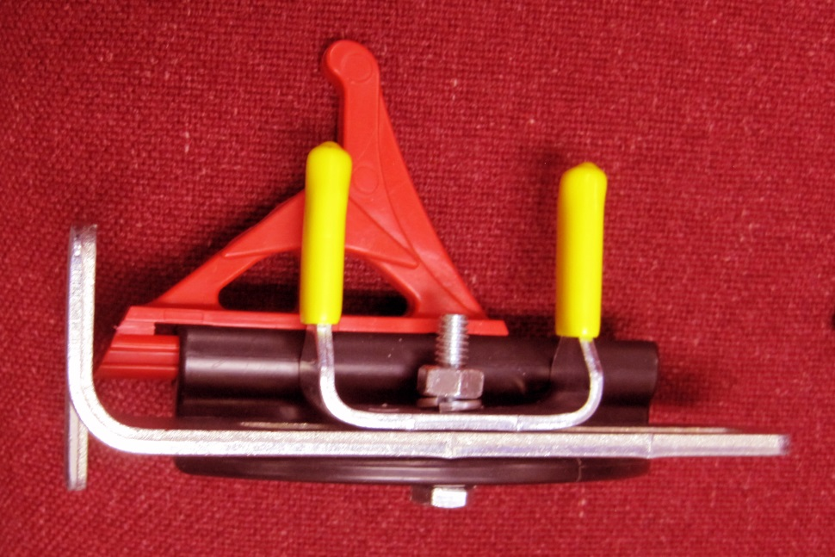
BRAKE SAFE ® ARROW LOGGER™ HOW IT WORKS
The Pre-measured reference unit with the yellow pin covers is attached to the steel, zinc plated mounting bracket together with the Logger Housing and the Logger Arrow Indicator.
Pre-measured reference unit
Logger Arrow Indicator
Mounting bracket
Logger Housing
Notes:
14

Slide 15
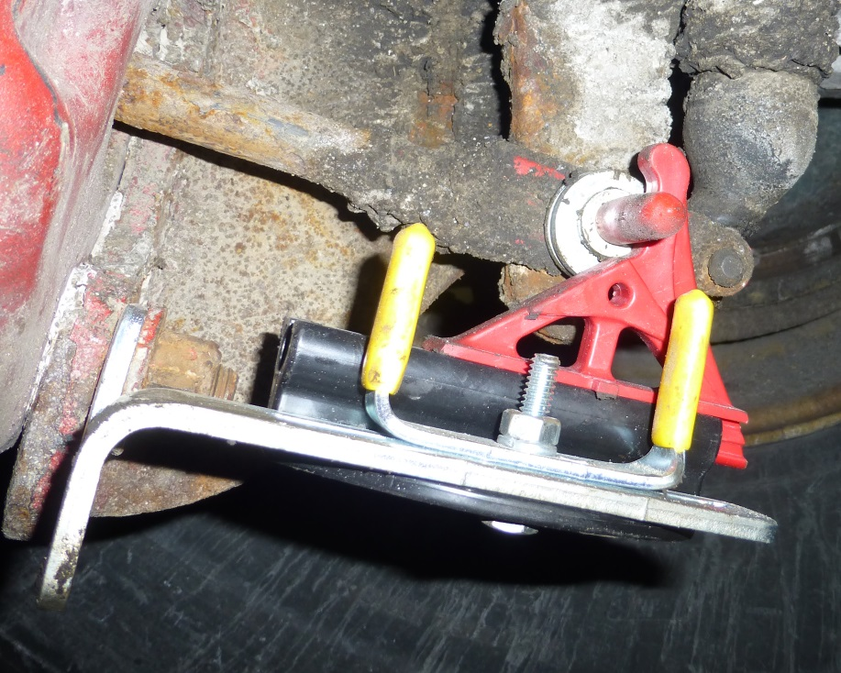
BRAKE SAFE® ARROW LOGGER™ HOW IT WORKS
The steel bracket with the pre-measured reference unit (Goalpost) and Logger Housing & Logger Arrow Indicator are mounted on the brake chamber using the existing mounting stud.
Logger Arrow Indicator
Brake Chamber, Mounting stud, Bracket
Logger Housing
Notes:
15

Slide 16
BRAKE SAFE® ARROW LOGGER™ HOW IT WORKS
Prior to a Brake Application, the Clevis Pin, U-shaped pre-measured reference unit (Goalpost) and Arrow Indicator are aligned. (fig. 1)
Notes:
16

Slide 17
BRAKE SAFE® ARROW LOGGER™ HOW IT WORKS
Full 90-100 psi Brake Application. Arrow Indicator is BETWEEN U-shaped reference unit (Goalpost) (fig.1).
BRAKE IS IN ADJUSTMENT
Full 90-100 psi Brake Application and Release. Arrow Indicator REMAINS BETWEEN U-shaped Goalpost
(fig.2).
BRAKE IS IN ADJUSTMENT

Slide 18
BRAKE SAFE® ARROW LOGGER™ HOW IT WORKS
Full 90-100 psi Brake Application. Arrow Indicator is BEYOND U-shaped reference unit (Goalpost) (fig.1).
BRAKE IS OUT OF ADJUSTMENT
Full 90-100 psi Brake Application and Release. Arrow Indicator REMAINS BEYOND U-shaped Goalpost
(fig.2).
BRAKE IS OUT OF ADJUSTMENT

Slide 19
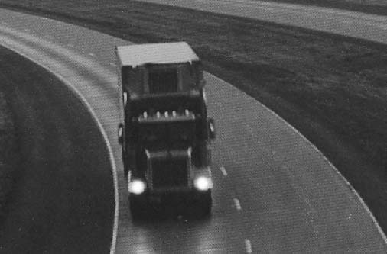
BRAKE SAFE® ARROW LOGGER™ will save all fleet operators time and money!
Reduced Maintenance Costs
No unnecessary brake adjustments
Pre-empt costly repairs
Improved Productivity
Mechanics & Drivers
Vehicles & Equipment
Improved Fleet Safety
Maximum braking capability in normal or emergency situations
Check vehicles & equipment brake adjustment status roadside without need to re-apply the service brakes
Notes:
19

Slide 20
BRAKE SAFE® ARROW LOGGER™ PRODUCT LINE: FULL KIT
UPUAL1:Universal Power Unit kit equips all HD Commercial vehicles including Tractors and most Trucks including: Refuse, Construction and Dump, Ready mix, Tanker,
Fire trucks, HD Tow trucks, School buses, Motor Coaches, etc.
UTLAL1: Universal Trailer kit equips most Trailers including: Box & Dry Van, Beverage, Bulk, Chassis, Aggregate, Livestock, Logging trailers, etc.
UTLAL2: Universal Trailer kit equips all trailers with SUPER SINGLE tires, Flatbed trailers, Auto hauler and Lowboy trailers.
Notes:
20

Slide 21
BRAKE SAFE® ARROW LOGGER™ PRODUCT LINE: RETROFIT KIT
AL01 kit attaches to all existing BRAKE SAFE® Power Unit/Truck kits and all Trailer kits.

Slide 22
Equip your fleet with the BRAKE SAFE® ARROW LOGGER™
For more information regarding BRAKE SAFE®
ARROW LOGGER™ contact:
Spectra Products Inc.
Toronto, Ontario, Canada
www.spectraproducts.ca
1-888-381-2355 416-252-2355
Notes:
22

