Slide 1
Introducing Brake Safe® …. The Visual Brake Stroke Indicator System
®
Notes:
1

Slide 2
Brake Safe® is a visual brake stroke indicator that shows brake stroke status without the need to crawl under the equipment.
Identifies brakes that are out-of- adjustment or approaching the adjustment limit
Detects non-activating brake chambers
Indentifies brakes that have failed to release
Indicates weak or broken parking brake springs
®
Notes:
2

Slide 3
Brake Safe® eliminates the number one fleet brake problem: OUT-OF-ADJUSTMENT BRAKES
OPERATION AIR BRAKE - SEPTEMBER 8-14, 2013 - CANADA & USA
OPERATION AIR BRAKE - SEPTEMBER 8-14, 2013 - CANADA & USA
OPERATION AIR BRAKE - SEPTEMBER 11-17, 2011 - CANADA & USA
Brake defects accounted for 59% of out-of-service violations.
Brake adjustment defects were the leading cause of brake related out-of -service violations (56% of all brake defects).
Vehicles equipped with Automatic slack adjusters accounted for 80% of out-of adjustment violations
Notes:
3

Slide 4
The Importance of Brake Adjustment
®
Proper Brake Adjustment Means Shorter Stopping Distance
Notes:
4

Slide 5
Brake Safe® Benefits
Reduced Maintenance Costs
Fewer unnecessary brake adjustments
Pre-empt costly repairs by identifying existing and potential brake repairs
Assists balanced braking reducing uneven brake and tire wear.
®
Notes:
5

Slide 6
Brake Safe® Benefits
Improved Fleet Productivity
Less driver time on brake pre-trip inspection
Less downtime from out- of- service infractions
Reduced PM time spent on foundation brake system
Equipment is on the road quicker with less downtime in shop
®
Notes:
6

Slide 7
Brake Safe® Benefits
Improved Fleet Safety
Ensure maximum braking capability in normal or emergency situations
Eliminate roadside infractions and resulting fines
No loss of brake related demerit points
Increase operator confidence in safety and reliability of fleet equipment
Demonstrate safety commitment to regulatory and inspection agencies
Notes:
7

Slide 8
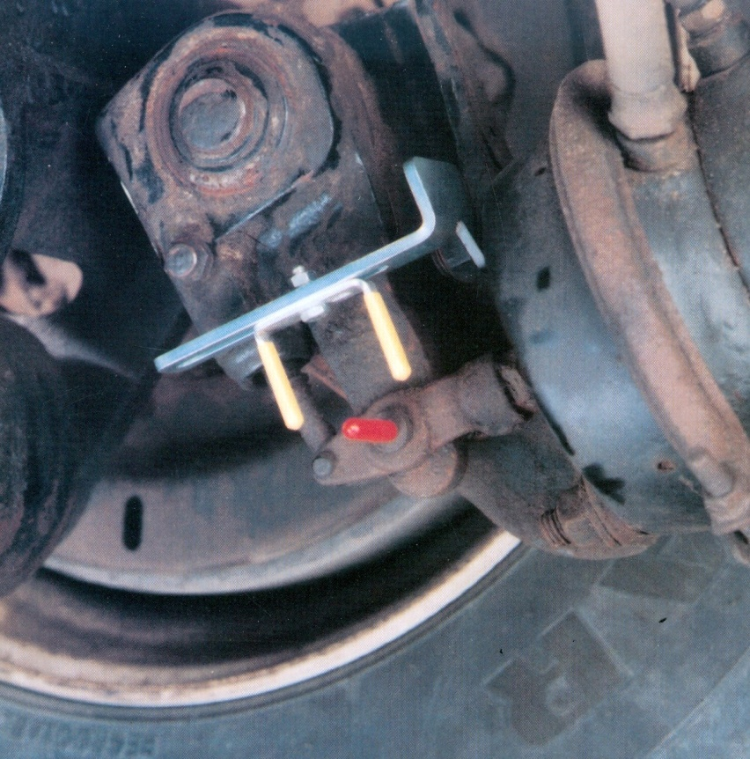
Brake Safe® Features
®
Brake stroke status shown at each
wheel-end position
Easy to see pre-measured
indicator units ensure
adjustment accuracy
Clevis pin has tooled pointer
for permanent visibility
Indicator Unit
Clevis Pin
Notes:
8

Slide 9
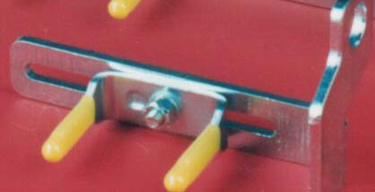
Brake Safe® Features
®
Brackets & Indicator units are fabricated in “one piece” for superior strength
High quality steel fabrication with corrosion resistant zinc plating for extended operational life
Steel Fabrication Zinc Plating “One piece” indicator unit
Notes:
9

Slide 10
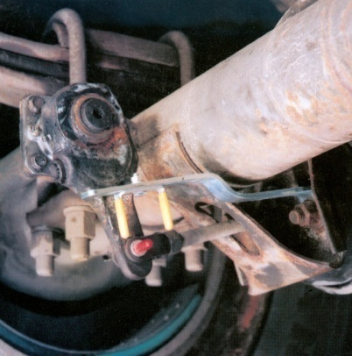
Brake Safe® Features
®
2 universal formats: one for trucks and one for trailers
Truck
Trailer
Notes:
10

Slide 11
Brake Safe® Features
®
Highly visible Brake Safe® identification sticker.
Installs in minutes with regular shop tools.
Notes:
11

Slide 12
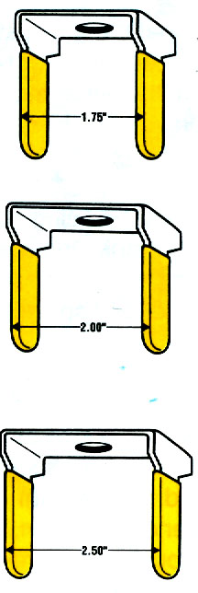
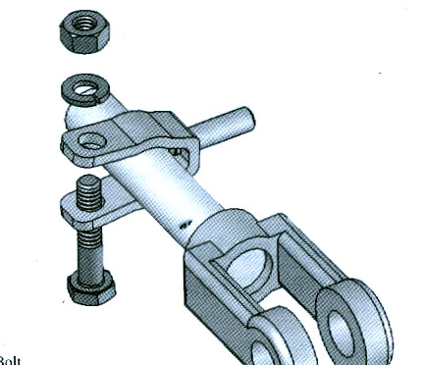
Brake Safe® Features
®
Pre-measured indicator units are set to DOT specifications of 1.75”, 2.00” or 2.50”
Replacement clevis pin and clamp pin have tooled point for permanent visibility and accuracy
Notes:
12

Slide 13
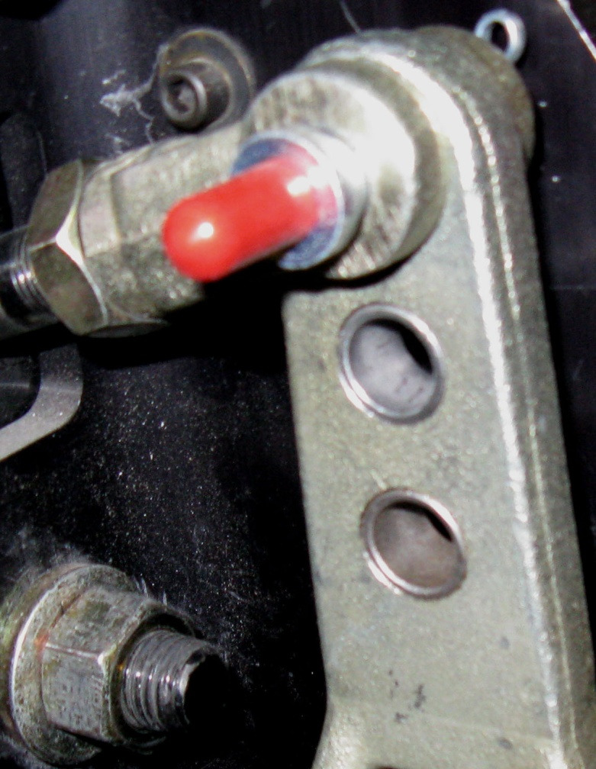
How Does Brake Safe® Work?
®
The Brake Safe® tooled
clevis pin with the red
pointer cover is inserted into
into the slack adjuster
yoke replacing the
existing clevis pin.
Tooled clevis pin
Notes:
13

Slide 14
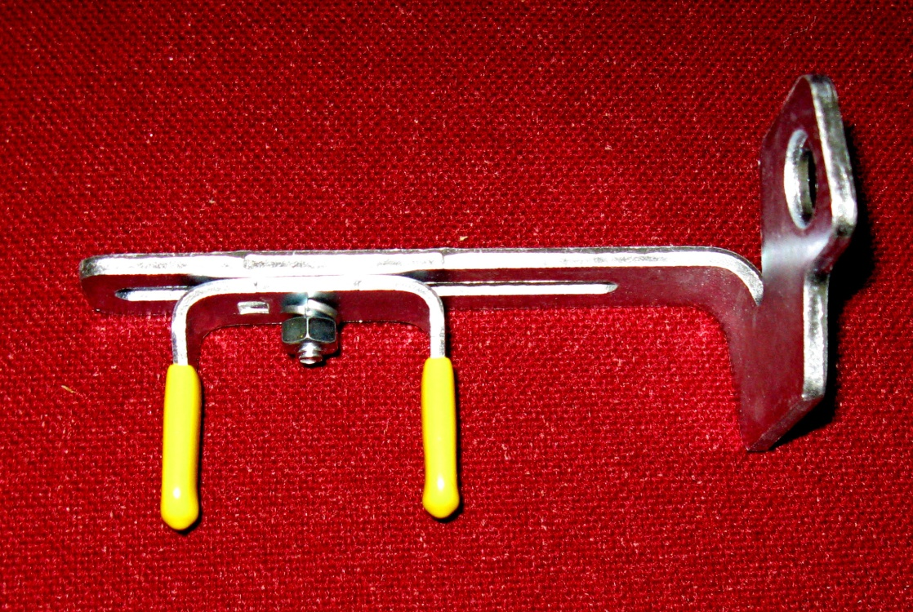
How Does Brake Safe® Work?
®
The Pre-measured reference unit with the yellow pin covers is attached to the steel, zinc plated mounting bracket.
Pre-measured reference unit
Mounting bracket
Notes:
14

Slide 15
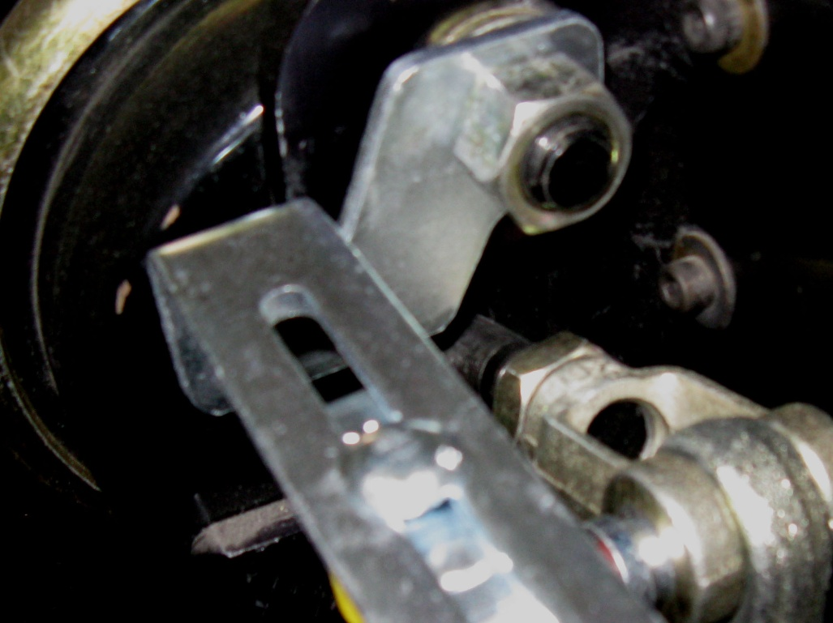
How Does Brake Safe® Work?
The steel bracket with the pre-measured reference unit is mounted on the brake chamber using the existing mounting stud.
Bracket with reference unit
Brake chamber mounting stud
Notes:
15

Slide 16
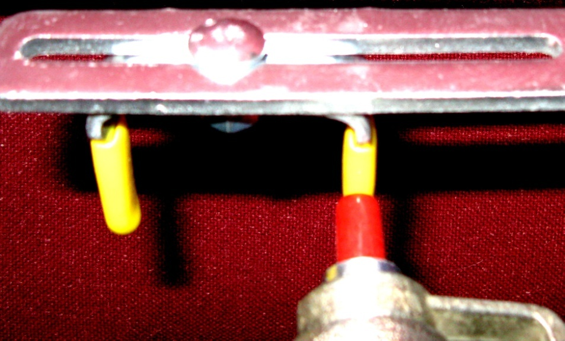
How Does Brake Safe® Work?
®
With the brakes released, the pre-measured reference unit is moved along the bracket slot to align with the tooled clevis pin pointer.
The clevis pin pointer is aligned center to center with the 1st pin of the indicator unit.
Bracket slot
1st pin of pre-measured reference unit
Clevis pin pointer
Notes:
16

Slide 17
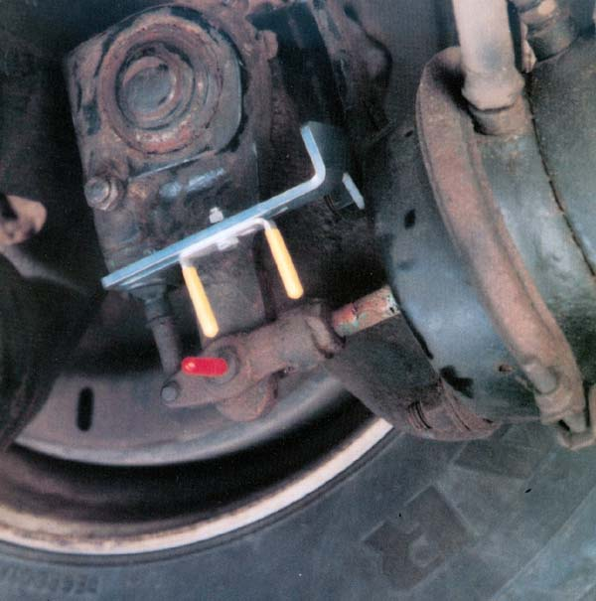
How Does Brake Safe® Work?
®
Brakes are applied with 90-100 psi and the push rod moves the clevis pin from the 1st pin of the pre-measured indicator unit towards 2nd pin.
Brakes are in-adjustment as long as the clevis pin pointer does not pass the indicator unit’s 2nd pin.
Brakes are out-of adjustment when the clevis pin pointer passes the indicator unit’s 2nd pin.
2nd pin
1st pin
Power Unit
2nd pin
1st pin
Power Unit
Notes:
17

Slide 18
Brake Safe® will save your fleet time and money!
Reduced Maintenance Costs
No unnecessary brake adjustments
Pre-empt costly repairs
Balanced braking
Improved Productivity
Mechanics
Drivers
Equipment
Improved Fleet Safety
Eliminate roadside detention
Avoid costly inspection fines
®
Notes:
18

Slide 19
Brake Safe® Product Line
Truck (Power Unit) Kits:
Brake Safe Clevis Chamber Ref.Unit Typical
Part No. Pin Size Types Stroke Applications
PU242 ½” 16,20,24 1.75” Most steering axles
PU250LS ½” 24LS,30LS sq.port 2.50” Long-stroke, square port chambers, drive & steer
PU250LSCP ½” 24LS,30LS sq.port 2 .50” Clamp-on pointer for long push rods
PU302 ½” 30,16L,20L,24L 2.00” Most drive axles & long stroke steering axles
PU302CP ½” 30 extended pushrod 2.00” Clamp-on pointer for long push rods
Trailer Kits:
Brake Safe Clevis Chamber Ref.Unit Typical
Part No. Pin Size Types Stroke Applications
TL250LS ½” 30LS sq.port 2.50” Long-stroke, square port chambers
TL250LSCP ½” 30LS sq. port 2.50” Vantraax & Intraax suspensions, clamp-on pointer
TL250LSS ½” 30 2.50” Super Single Wheel application
TL302 ½” 30 2.00” Regular 30-30 brake chambers
TL302CP ½” 30 2.00” Vantraax & Intraax suspensions, clamp-on pointer
TL302 S ½” 30 2.00” Super Single Wheel application
Note: Kits with 5/8 inch clevis pins are available
®
Notes:
19

Slide 20
Equip your fleet with Brake Safe® today!
For more information on Brake Safe®:
Spectra Products Inc.
Toronto, Ontario, Canada
www.spectraproducts.ca www.brakesafe.ca
1-888-381-2355 416-252-2355
®
Notes:
20

