Slide 1
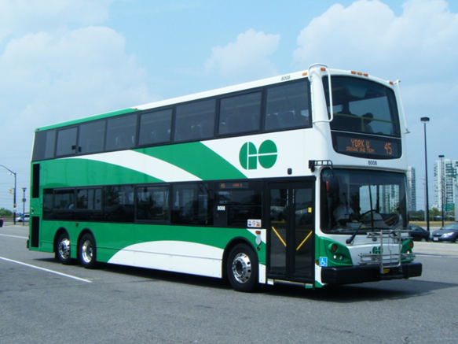
TERMIN-8R® Anti-Corrosion Spray Lubricant
MAINTENANCE APPLICATIONS
FOR TRANSIT VEHICLES

Slide 2
SERVICE ALL TRANSIT VEHICLE ELECTRICAL AND MECHANICAL COMPONENTS
DURING REGULAR MAINTENANCE CYCLES, APPLY TERMIN-8R TO ALL VEHICLE ELECTRICAL AND MECHANICAL COMPONENTS:
Lubricate
Clean
Protect
Termin-8R is formulated to LUBRICATE, CLEAN, and PROTECT electrical and mechanical systems and components when applied during regular maintenance cycles. With a high dielectric component, Termin-8R can also improve electrical current flow.

Slide 3
SERVICE ALL TRANSIT VEHICLE ELECTRICAL AND MECHANICAL COMPONENTS
MAIN ELECTRICAL CONTROL BOX
FRONT DOOR OPERATION
REAR DOOR OPERATION
WINDOW & DOOR MECHANISMS
WHEELCHAIR RAMP MECHANISM
AIR CONDITIONING SYSTEM
VEHICLE LIGHTING SYSTEM
VEHICLE SYSTEMS & COMPONENTS
This presentation will focus on eight areas where the application of Termin-8R will result in improved performance and extended parts operation.

Slide 4
1. MAIN ELECTRICAL CONTROL BOX Lubricate, Clean and Protect Electrical Components
1. Circuit Breaker
2. Relays
3. Dinex I.O. Module
4. Air Pressure Switches
Termin-8r should be sprayed liberally on the surfaces of all electrical components including Circuit Breakers; Relays; the Dinex I.O. Module; and Air Pressure Switches.

Slide 5
1. MAIN ELECTRICAL CONTROL BOX Lubricate, Clean and Protect Electrical Components
1. Terminal Strip
2. Wire Connections
3. Air Pressure Valves
Lubricate, Clean and Protect Terminal Strips; all Wire Connections; and Air Pressure Valves.

Slide 6
1. MAIN ELECTRICAL CONTROL BOX Lubricate, Clean and Protect Electrical Components
1. Ignition Switch
2. Dash Panel Lights
3. Driver Door Control
Spray Termin-8R on the surface and connection points for the Ignition Switch; the Dash Panel Lights; and the Driver Door Control. Termin-8R will spread across these surfaces penetrating hard to reach areas and providing long-term protection.

Slide 7
1. MAIN ELECTRICAL CONTROL BOX Lubricate, Clean and Protect Electrical Components
1. Wiring Connections
2. Light Switch
3. Overdrive Switch
Make sure Termin-8R is applied to the numerous Electrical Terminals and Connection Points; and to all Switch Mechanisms including the Light and Overdrive Switches.

Slide 8
1. MAIN ELECTRICAL CONTROL BOX Lubricate, Clean and Protect Electrical Components
1. Ground Points
2. Connectors
3. Latches
Spray all Ground Points and Connectors. When doing the connectors, separate the male and female parts and spray Termin-8R on the pins and receptacles for removal of existing corrosion and protection against future corrosion. Lubricate all Latches.

Slide 9
1. MAIN ELECTRICAL CONTROL BOX Lubricate, Clean and Protect Electrical Components
Driver Ignition Switch
Terminal Strip
Spray the Driver Ignition Switch and the adjacent Terminal Strips.

Slide 10
1. MAIN ELECTRICAL CONTROL BOX Lubricate, Clean and Protect Electrical Components
1. Brake “Pull Away” Pressure
Switch & Electrical Connections
Make sure you treat the Brake “Pull Away” Switch and the corresponding Electrical Connections.

Slide 11
2. Front Door Operation Overhead Panel Lubricate, Clean and Protect Electrical & Mechanical Components
Solenoids
Plug Connectors
Panel Arm & Slider
Surfaces, Arms & Pivots
Spray Termin-8R liberally on all Solenoids; Plug Connectors; and the Panel Support Arm and Slider. Pay careful attention to any Surfaces, Arms and Pivots that are prone to corrosion from moisture and condensation.

Slide 12
2. Front Door Operation Overhead Panel Lubricate, Clean and Protect Electrical & Mechanical Components
Air Control Door Motor
Micro-switches
Fasteners, Arms & Pivots
Lubricate and protect the Air Control Door Motor; any Micro-switches; and again all Fasteners, Arms and Pivots.

Slide 13
3. Rear Door Operation Overhead Panel Lubricate, Clean and Protect Electrical & Mechanical Components
Pins & Pivots
Door Springs
Threaded Valves & Fasteners
Door Closer Switches (Sensitive Edge)
As with the front door service, lubricate all Pins and Pivots to ensure unrestricted motion; Spray the Door Springs; Threaded Valves and Fasteners; and the Door Closer, Sensitive Edge Switch.

Slide 14
3. Rear Door Operation Overhead Panel Lubricate, Clean and Protect Electrical & Mechanical Components
Terminal Strip
Capacitor
Jumpers &, Grounds
Apply Termin-8R to the Terminal Strips; Capacitors; and all Jumpers and Grounds.

Slide 15
3. Rear Door Operation Overhead Panel Lubricate, Clean and Protect Electrical & Mechanical Components
Door Adjusting Linkage, Fasteners & Connectors
1. Pins & Linkages 2. Connectors 3. Arms & Linkages 4. Bolts & Fasteners
Spray Termin-8R on Pins and Linkages; Connectors; Arms and Linkages; and Bolts, Nuts and other Fasteners.

Slide 16
3. Rear Door Operation Overhead Panel Lubricate, Clean and Protect Electrical & Mechanical Components
Relays including leading edge facing air flow from A/C unit
Spray all Relays to protect surfaces from corrosion. Here you can see the corroding effects of moisture and condensation from the Air Conditioning Unit that can be eliminated by using Termin-8R.

Slide 17
4. Window and Door Mechanisms Lubricate, Clean and Protect Mechanical Components
Door Bearings
Door Bearings are areas where lubrication and corrosion protection is very important.

Slide 18
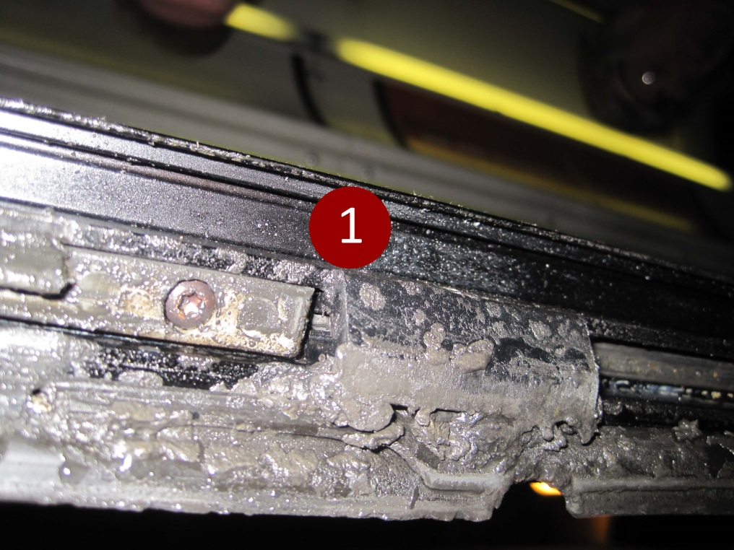
4. Window and Door Mechanisms Lubricate, Clean and Protect Mechanical Components
1. Latches, Catches & Stoppers
Spray Termin-8r on Window Latches, Catches and Stoppers.

Slide 19
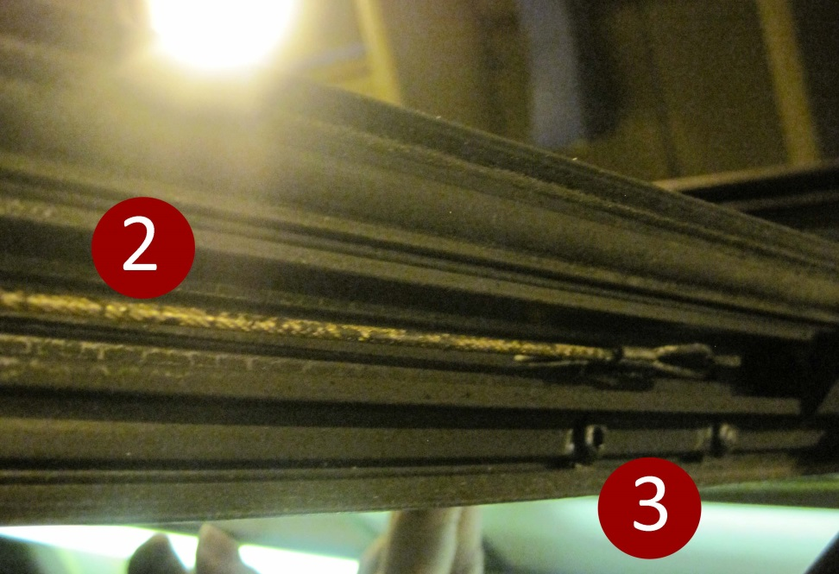
4. Window and Door Mechanisms Lubricate, Clean and Protect Mechanical Components
Window Springs
Window Cables
Tracks and Rails
Lubricate, Clean and Protect Window Springs… Cables… Tracks and Rails.

Slide 20
5. Wheelchair Ramp Mechanism Lubricate, Clean and Protect Mechanical Components
Rails
Sliders
Hinges
Servicing the Wheel Chair Ramp should include applying Termin-8R to the Rails, Sliders and Hinges.

Slide 21
5. Wheelchair Ramp Mechanism Lubricate, Clean and Protect Mechanical Components
Ramp Deployment Control Arm
Make sure the Ramp Deployment Arm is well lubricated.

Slide 22
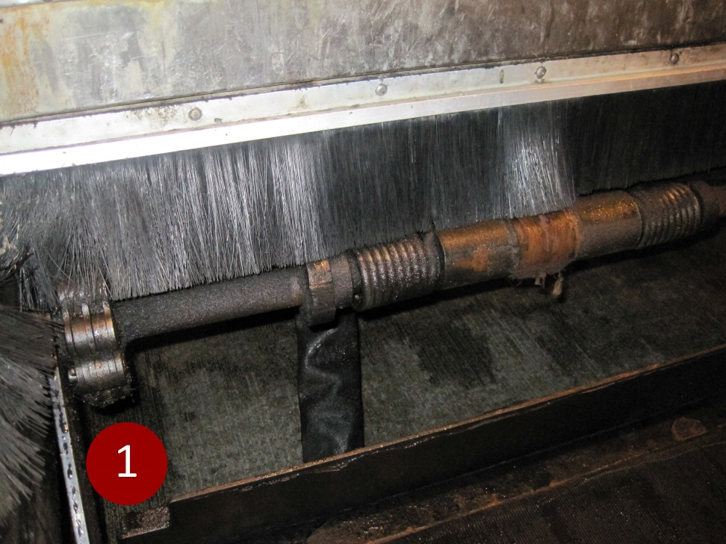
5. Wheelchair Ramp Mechanism Lubricate, Clean and Protect Mechanical Components
Chain Linkages
Spray the Chain Linkages liberally with Termin-8R to reduce friction, remove corrosion and provide trouble free operation.

Slide 23
5. Wheelchair Ramp Mechanism Lubricate, Clean and Protect Electrical & Mechanical Components
Ramp Proximity Switch
Make sure that the Ramp Proximity Switch gets a decent dose of Termin-8R

Slide 24
5. Wheelchair Ramp Control Lubricate, Clean and Protect Electrical & Mechanical Components
Plugs & Connectors
Solenoid Valve Over-ride Testing Plunger
Couplings & Fittings
In the Ramp Control area, apply Termin-8R to all Plugs and Connectors; the Solenoid Valve; and the Over-ride Testing Plunger, which seems to regularly seize up. Spray the various Couplings and Fittings.

Slide 25
6. Air Conditioning System Lubricate, Clean and Protect Electrical & Mechanical Components
Solenoid & Connections
Breaker & Connections
Apply Termin-8R to clean and protect Solenoids and Connection Points, and Breakers and Connection Points.

Slide 26
6. Air Conditioning System Lubricate, Clean and Protect Electrical & Mechanical Components
Circuit Breakers
Fuses & Sockets
Diagnostic Pins
Spray Termin-8R liberally on all circuit Breaker Switches, Fuses and Sockets, and Diagnostic Pins. Termin-8R will provide reliable circuitry performance with no interruption of current flow CAUSED BY CORROSION.

Slide 27
7. Vehicle Lighting and Signage Lubricate, Clean and Protect Electrical Connections & Components
Head Lights and Turn Signals
Destination Sign
Marker Lighting
Spray the Lighting Pins and Sockets of all bulbs to lubricate and clean contact points. Termin-8R will provide ongoing protection against corrosion while restoring previously interrupted current flow. Application should include the Headlights and Turn Signals; Destination Signage and all front and side Marker Lights.

Slide 28
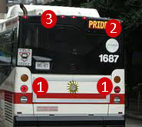
7. Vehicle Lighting and Signage Lubricate, Clean and Protect Electrical Connections & Components
Braking, Turn Signal & Reverse Lights Array
Route Identification
Signage
3. Marker Lighting
At the rear of the vehicle, apply Termin-8R to all Electrical Connection Points including Rear Brake, Turn Signal and Back up Lights; the Route Signage; and Marker lighting. When servicing the Destination and Route messaging signs, you can spray Termin-8R on the circuit boards for corrosion protection and extended operating life.

Slide 29
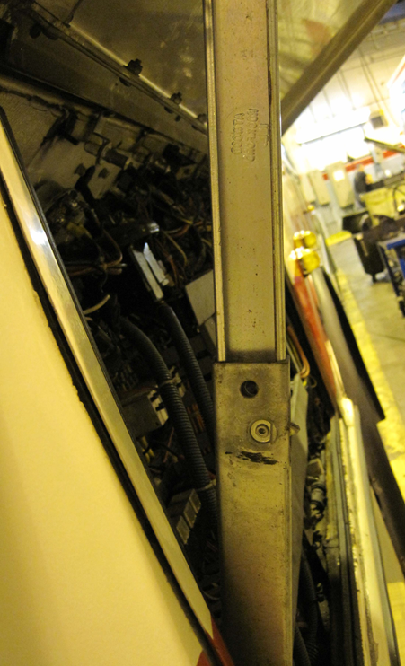
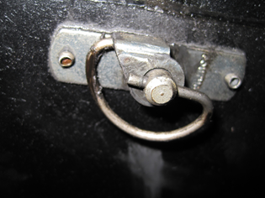
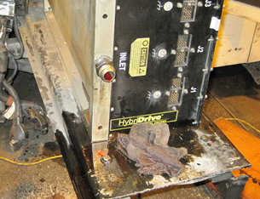
8. Vehicle Systems & Equipment Lubricate, Clean and Protect Mechanical Components
Latches • stoppers • catches• Sliders •rails • hinges • arms
Use Termin-8r wherever you encounter the variety of Latches, Stoppers, Catches, Sliders, Rails, Hinges and Support Arms that are part of the vehicle.

Slide 30
8. Vehicle Systems & Equipment Lubricate, Clean and Protect Electrical & Mechanical Components
pressure Tank valves, brackets, Fittings
Battery terminals
Spray Termin-8R on the Pressure Tank Valves; Brackets; and Fittings. Make sure that you apply Termin-8r to the Battery Terminals to remove oxidation build-up and ensure continuous current flow.

Slide 31
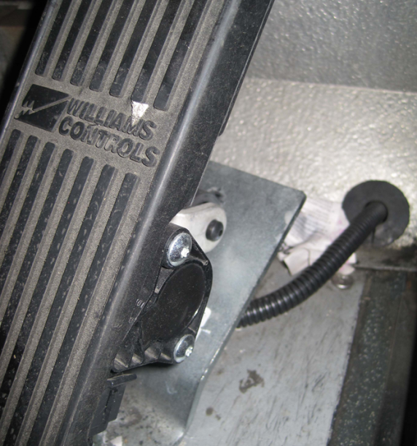
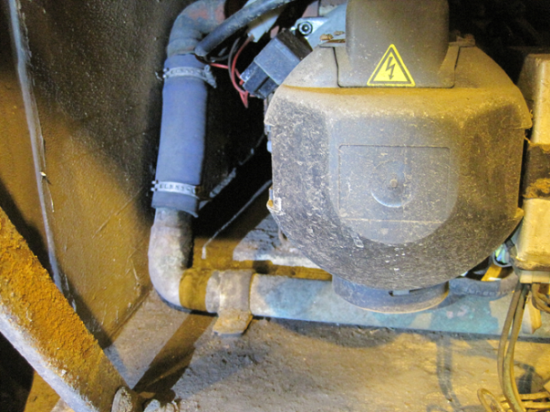
8. Vehicle Systems & Equipment Lubricate, Clean and Protect Mechanical Components
pedal pins • Fan blades, Pulleys & fasteners
Wiper Arm • Pre-heater connectors, clamps & Fasteners
Termin-8R can be used for numerous other components and pieces of equipment including:
Wiper arms
Pre-heater Connectors, Clamps and Fasteners
Pedal Pins
Fan blades
Pulleys and Fasteners

Slide 32
Termin-8R Anti-Corrosion Spray Lubricant

Slide 33
INTRODUCE TERMIN-8R TO YOUR MAINTENANCE OPERATION!!
FOR MORE INFORMATION CONTACT:
Spectra Products Inc.
Toronto, Ontario, Canada
888-381-2355
416-252-2355
info@spectraproducts.ca
www.spectraproducts.ca

