Slide 1
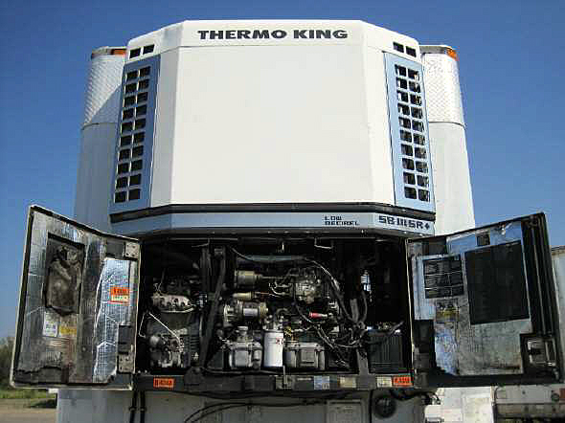
Termin-8r ® Anti-Corrosion Spray Lubricant
Reefer Service

Slide 2
Termin-8r ® Anti-Corrosion Spray Lubricant
MULTI- FUNCTIONAL
Penetrating System
Cleaning System
Inhibitor System
Lubricating System

Slide 3
Termin-8r ® Anti-Corrosion Spray Lubricant
Use TERMIN-8R to Service REEFER Components
1. Free up seized and frozen parts
2. Remove Surface Moisture and Corrosion
3. Protect Against Rust and Oxidation
4. Lubricate to reduce friction, heat and noise
5. Improve Electrical Current Flow

Slide 4
Termin-8r ® Anti-Corrosion Spray Lubricant

Slide 5
Termin-8r ® Anti-Corrosion Spray Lubricant

Slide 6
Termin-8r ® Anti-Corrosion Spray Lubricant

Slide 7
Termin-8r ® Anti-Corrosion Spray Lubricant

Slide 8
Termin-8r ® Anti-Corrosion Spray Lubricant

Slide 9
Termin-8r Anti-Corrosion Spray Lubricant

Slide 10
Termin-8r ® Anti-Corrosion Spray Lubricant

Slide 11
Termin-8r® Anti-Corrosion Spray Lubricant

Slide 12
Termin-8r ® Anti-Corrosion Spray Lubricant

Slide 13
Termin-8r® Anti-Corrosion Spray Lubricant

Slide 14
Termin-8r ® Anti-Corrosion Spray Lubricant

Slide 15
Termin-8r Anti-Corrosion Spray Lubricant
TERMIN-8R is a highly effective tool to ensure Reefer Components are free of corrosion and remain corrosion free.
TERMIN-8R will provide superior, ongoing Lubrication ensuring extended parts life and operational reliability.
TERMIN-8R will improve electrical connection and current flow for all electrical connections.

Slide 16
Termin-8r ® Anti-Corrosion Spray Lubricant
FOR MORE INFORMATION ON TERMIN-8R ® :
Spectra products Inc.
Toll free: 1-888-381-2355
Tel: 416-252-2355
Fax: 416-252-2355
email: info@spectraproducts.ca
www.spectraproducts.ca

