Slide 1
TERMIN-8R® Anti-Corrosion Spray Lubricant
MAINTENANCE APPLICATIONS FOR MOTOR COACHES

Slide 2
SERVICE ALL MOTOR COACH ELECTRICAL AND MECHANICAL COMPONENTS
DURING REGULAR MAINTENANCE CYCLES, APPLY TERMIN-8R® TO ALL VEHICLE ELECTRICAL AND MECHANICAL COMPONENTS:
Lubricate
Clean
Protect
Termin-8R is formulated to LUBRICATE, CLEAN, and PROTECT electrical and mechanical systems and components when applied during regular maintenance cycles. With a high dielectric component, Termin-8R can also improve electrical current flow.

Slide 3
SERVICE ALL MOTOR COACH ELECTRICAL AND MECHANICAL COMPONENTS
MAIN ELECTRICAL CONTROL BOX
REAR ELECTRICAL CONTROL BOX
ENGINE COMPARTMENT
FRONT BUMPER ASSEMBLY
WINDSHIELD WIPER & DOOR MECHANISMS
CARGO STORAGE AREAS
CHAIR LIFT MECHANISM
HEATING, VENTILATION & COOLING SYSTEM
VEHICLE LIGHTING & SIGNAGE
This presentation will focus on nine key areas where the application of Termin-8R will result in improved performance and extended parts operation.

Slide 4
1. MAIN ELECTRICAL CONTROL BOX Lubricate, Clean and Protect Electrical Connections
Terminal Connections
Ground Points
Termin-8r should be sprayed liberally on the surfaces of all electrical components including Terminal Connections and Ground Points.

Slide 5
1. MAIN ELECTRICAL CONTROL BOX Lubricate, Clean and Protect Electrical Components
Relay Connections
Lubricate, clean and protect all Relay Connections.

Slide 6
1. MAIN ELECTRICAL CONTROL BOX Lubricate, Clean and Protect Electrical & Mechanical Components
Air Regulator & Valves
Connectors
Electronic A/C Evaporator Unit
Spray Termin-8R on the surface and connection points for the Air Regulator and Valves; electrical Connectors; and the A/C Evaporator Unit. Termin-8R will spread across these surfaces penetrating hard to reach areas providing long-term protection.

Slide 7
1. MAIN ELECTRICAL CONTROL BOX Lubricate, Clean and Protect Electrical & Mechanical Components
Steering Box Fittings
Air Valves
Brake Pedal Pivot
Steering Shaft U-joint Fittings
Use Termin-8R to lubricate Steering Box Fittings; Air Valves; the Brake Pedal Pivot; and the Steering Shaft U-Joint Fittings.

Slide 8
1. MAIN ELECTRICAL CONTROL BOX Lubricate, Clean and Protect Electrical Components
Brake Light Pressure Switches
Kneeling System Relays
Air Line Fittings
Termin-8R can be applied to the Brake Light Pressure Switch; Kneeling System Relays; and all Air Line Fittings. Using Termin-8R will remove existing corrosion and protect against future corrosion.

Slide 9
2. REAR ELECTRICAL CONTROL BOX Lubricate, Clean and Protect Electrical Components
Onboard Computer Unit Circuit Boards
Input / Output Connectors
3. Relays
4. Flasher Unit
Use Termin-8R to service all electrical components located in the REAR ELECTRICAL CONTROL BOX. This includes the Onboard Computer Unit Circuit Boards; all Input / Output Connectors; Relays, and the Flasher Unit.

Slide 10
2. REAR ELECTRICAL CONTROL BOX Lubricate, Clean and Protect Electrical Components
1. Battery Terminals
Also make sure you treat the Battery Terminals and Bolt Fasteners in the REAR ELECTRICAL CONTROL BOX.

Slide 11
2. REAR ELECTRICAL CONTROL BOX Lubricate, Clean and Protect Electrical & Mechanical Components
Lavatory Heater Fittings
Valves and Fittings
Locking Assembly
Spray Termin-8R liberally on the Lavatory Heater Fittings; various Valves and Fittings; and the Locking Assembly.

Slide 12
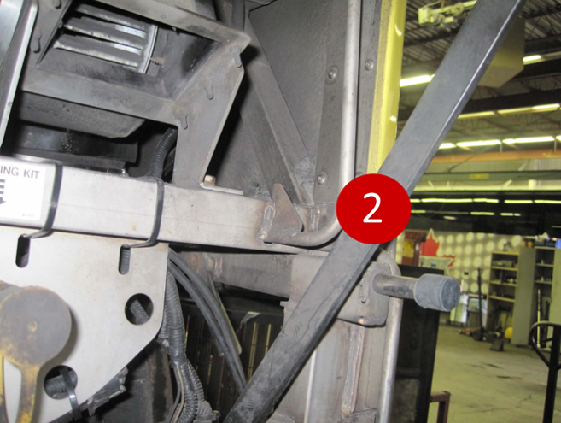
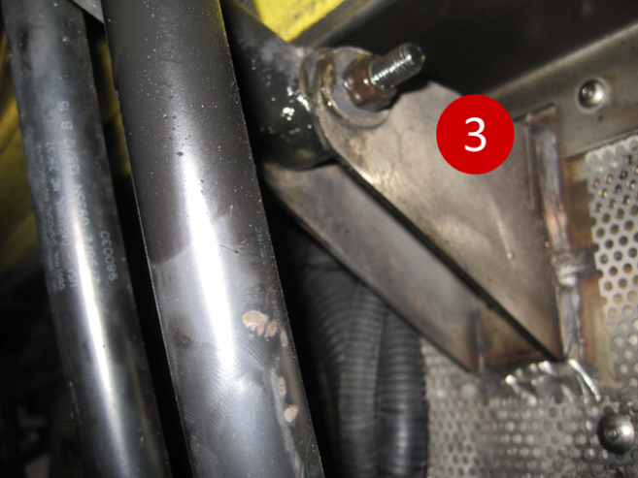
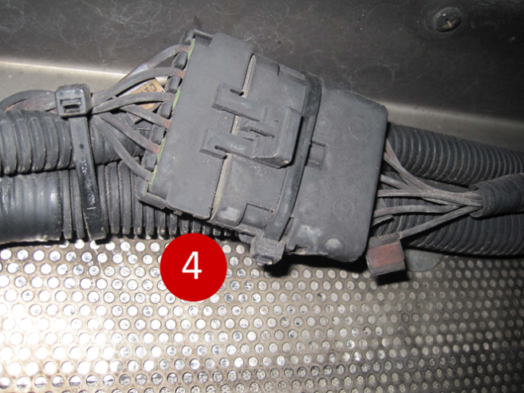
3. Engine Compartment Lubricate, Clean and Protect Electrical & Mechanical Components
Latches
Sliders
Supports
& Pivots
4. Connectors
In the ENGINE COMPARTMENT, lubricate and protect all moving components including Latches; Sliders; and Supports and Pivots. Use Termin-8R on all Connectors making sure you pull apart the Connectors to spray all pins and sockets.

Slide 13
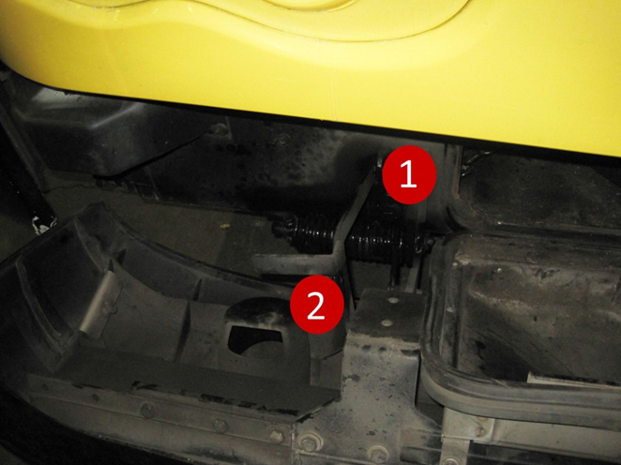
4. Front Bumper Assembly Lubricate, Clean and Protect Mechanical Components
Springs 2. Latch 3. Fasteners 4. Bumper Catch
Termin-8R should be applied to the Front Bumper Assembly, coating all Springs; Latches; Fasteners; and the Bumper Catch.

Slide 14
5. Windshield Wiper & Door Mechanisms Lubricate, Clean and Protect Mechanical Components
1. Arm & Linkages 4. Lock Catch
2. Pivot & Fastener 5. Door Lever
3. Blade Arm Surfaces 6. Bolts & Fasteners
Use Termin-8R to lubricate the WINDSHIELD WIPER APPARATUS including the Arm and Linkages; the Pivot and Fastener; and the Blade Arm Surfaces. Similarly, lube the DOOR MECHANISM including the Door Lock Catch; the Door Lever; and all Bolts and Fasteners.

Slide 15
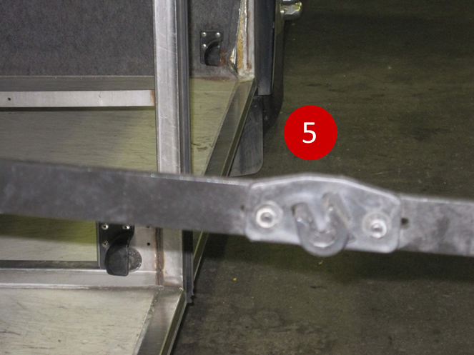
6. Cargo Storage Bays Lubricate, Clean and Protect Mechanical Components
Latch Fastener
Retainer Catch
Hinge & Slider
Support Arms, Hinges & Sliders
Panel Arm Support Slider
In the CARGO STORAGE BAY SECTION, lubricate, clean and protect the various mechanical components including the Latch Fastener; Retainer Catch; Hinges and Sliders; all Support Arms; and the Panel Arm Support and Slider.

Slide 16
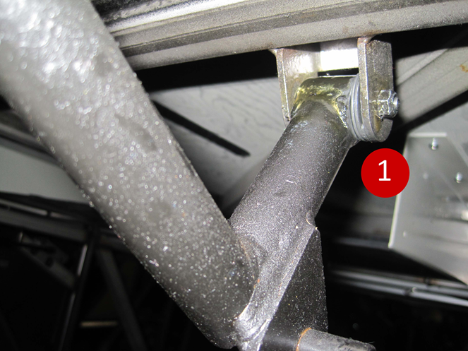
6. Cargo Storage Bays Lubricate, Clean and Protect Mechanical Components
Cargo Panel Hinge Pivot
Panel Release Bar
Panel Lock Mechanism
Also spray Termin-8R on the Cargo Panel Hinge Pivot; the Panel Release Bar; and the Panel Lock Mechanism.

Slide 17
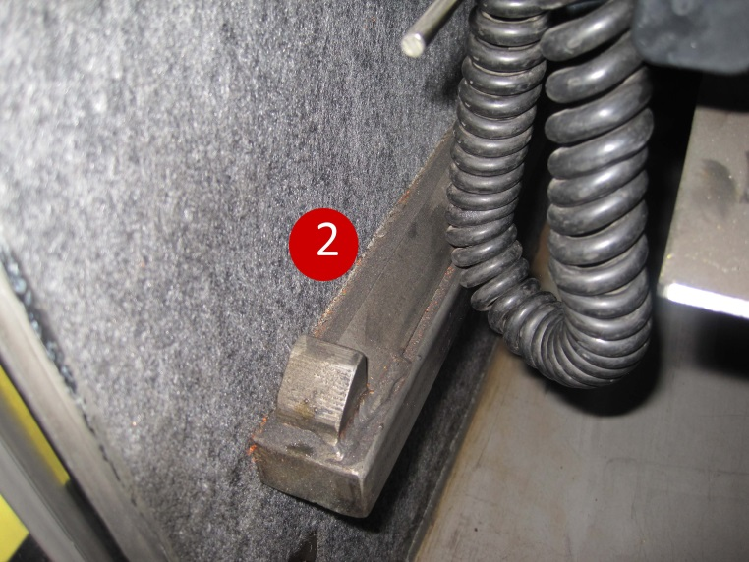
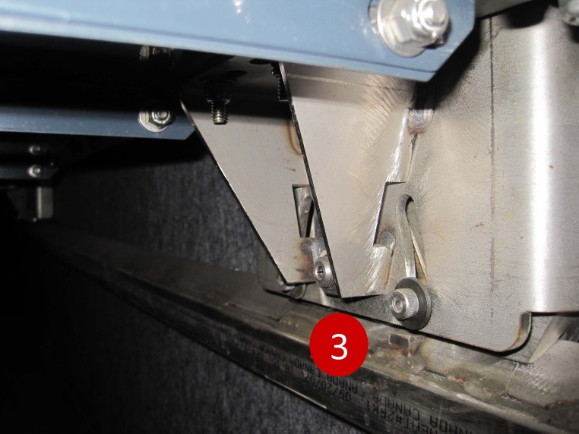
7. Chair Lift Mechanism Lubricate, Clean and Protect Mechanical Components
1. Chair Slider 2. Rail and Stopper
3. Track and Rollers
Termin-8R will extend the operating life of the CHAIR LIFT MECHANISM. Lubricate the Chair Slider; Rails and Stoppers; and the Tracks and Rollers.

Slide 18
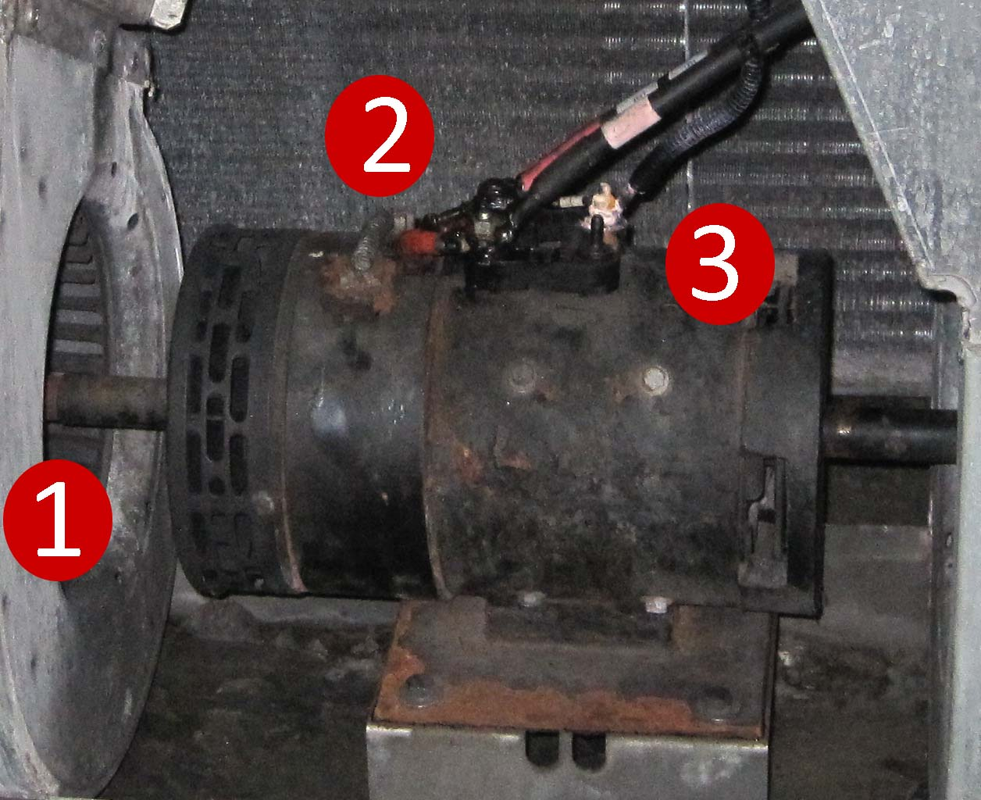
8. Heating, Ventilation, Cooling System Lubricate, Clean and Protect Electrical & Mechanical Components
Fan Drum Shaft & Bearings
Blower Motor Fittings
Electrical Terminals
Use Termin-8R to lubricate and protect electrical and mechanical components of the HVAC SYSTEM. Spray Termin-8R on the Fan Drum Shaft and Bearings; Blower Motor Fittings; and Electrical Terminals.

Slide 19
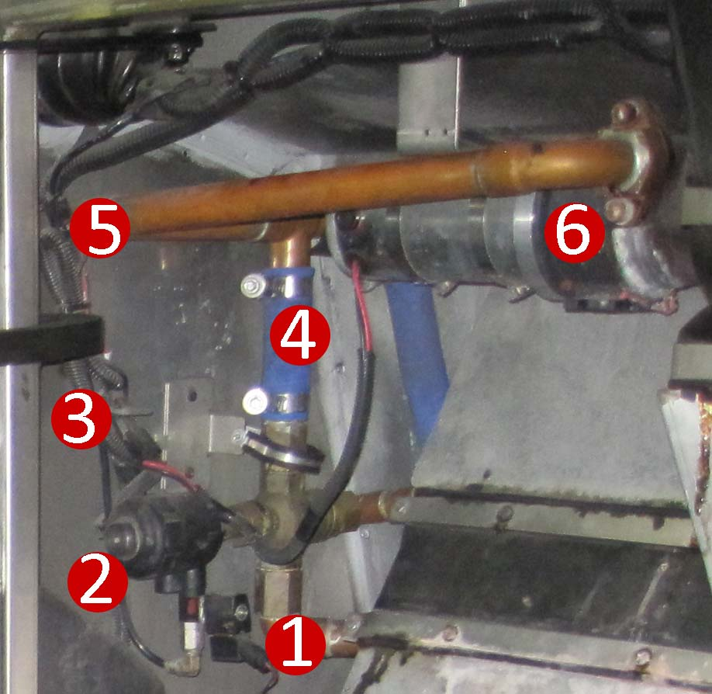
8. Heating, Ventilation, Cooling System Lubricate, Clean and Protect Electrical & Mechanical Components
Relay
2. Solenoid & Fittings
Electrical Ground Connection
4. Clamps & Couplings
5. Plug Connectors
6. Accessory Pump
While servicing the HVAC SYSTEM, lubricate Relays; Solenoid Fittings and the Electrical Ground Connection. Spray Termin-8R directly onto all Clamps and Couplings; Plug Connectors and the Accessory Pump.

Slide 20
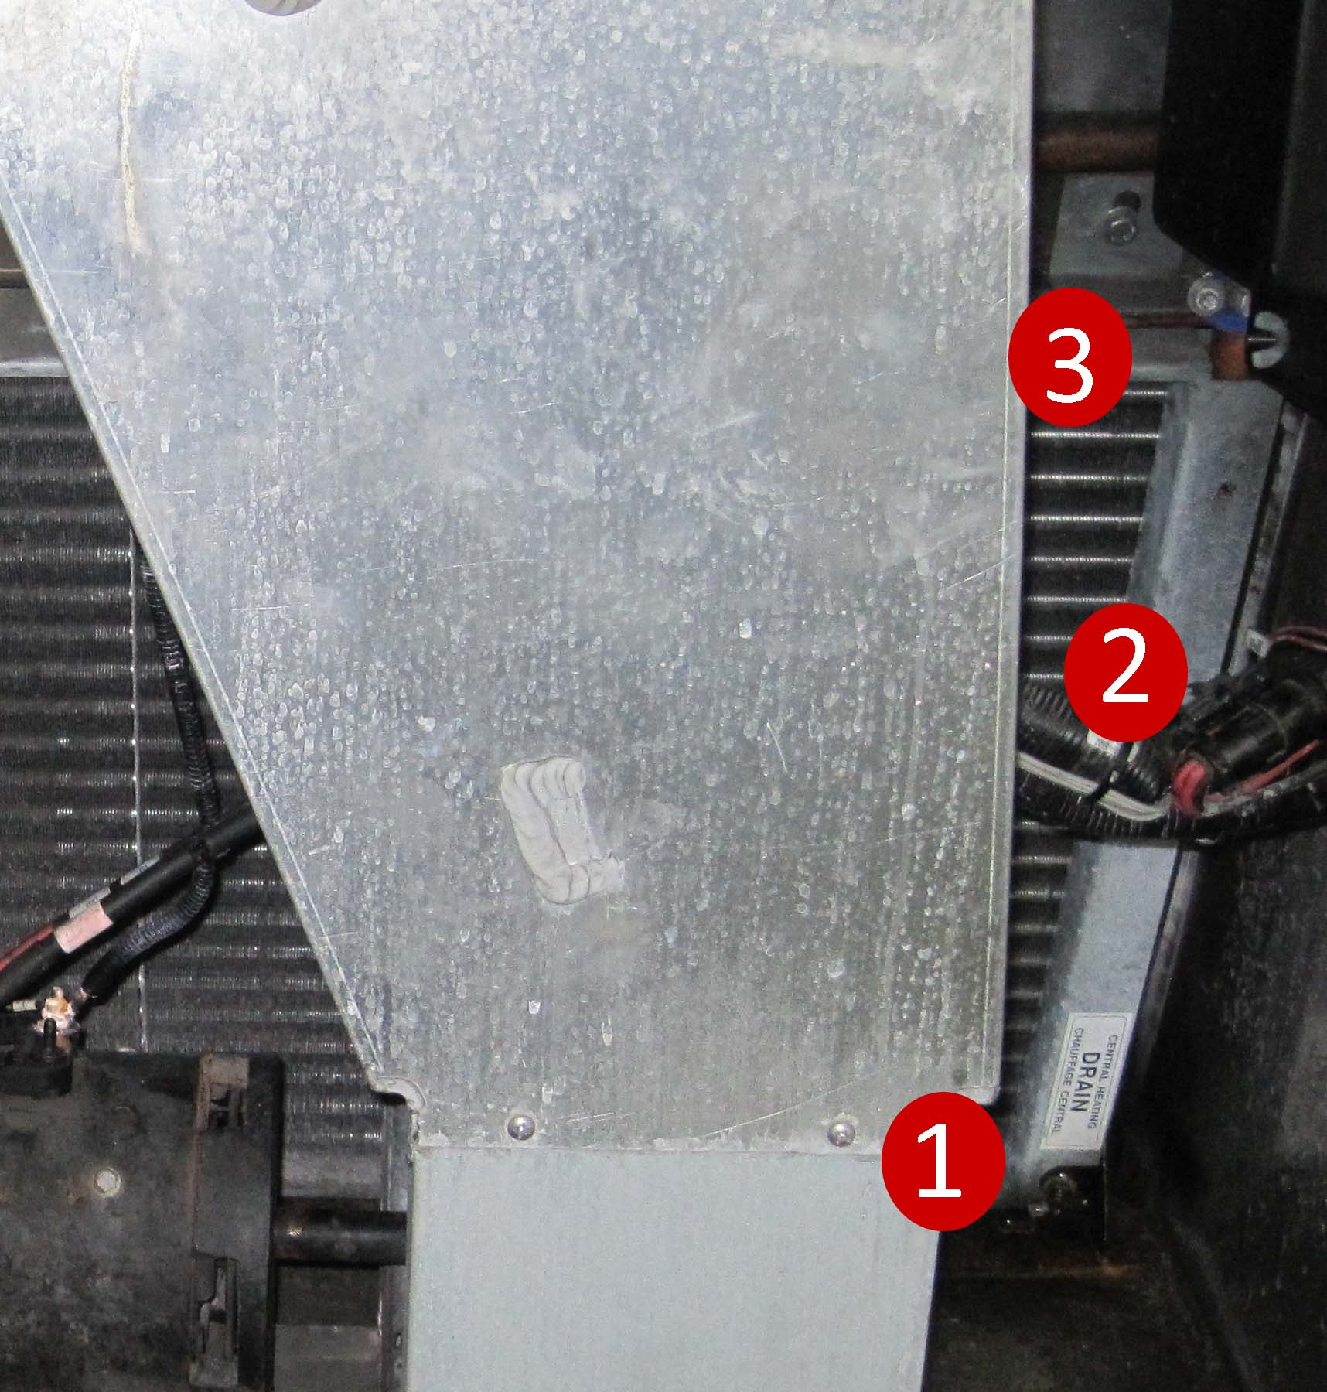
8. Heating, Ventilation, Cooling System Lubricate, Clean and Protect Electrical & Mechanical Components
Drain Valve Fitting
Plug Connectors
Fasteners
Similarly apply Termin-8R to the Drain Valve Fitting; Plug Connectors; and all self- tapping Fasteners.

Slide 21
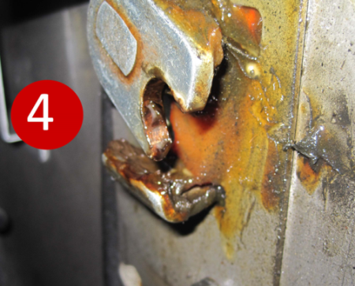
8. Heating, Ventilation, Cooling System Lubricate, Clean and Protect Mechanical Components
Panel Catch
Lower Pivot & Hinge
Upper pivot & Hinge
Panel Latch
Service the HVAC access panel making sure to spray Termin-8R on the Panel Catch; Upper and Lower Pivots and Hinges; and the Panel Latch.

Slide 22
8. Heating, Ventilation, Cooling System Lubricate, Clean and Protect Mechanical Components
1. Radiator Fins & Couplings 2. Door Seals
To prevent oxidation and corrosion, Termin-8R can be applied to the Radiator Fins and Couplings. This will also help prevent the build-up and accumulation of dirt and other environmental contaminants on the radiator. Spray the Door Seals to maintain surface flexibility and extend operational life.

Slide 23
9. Vehicle Lighting and Signage Lubricate, Clean and Protect Electrical Components
Head Lights and Turn Signals
Destination Sign
Signal Lighting
Marker Lights
Termin-8R should be applied to the entire vehicle lighting system. Lubricate, clean and protect the Head Lights and Turn Signals; Destination Signage; Side Signal Lights; and Marker Lighting. Remember to apply Termin-8R to the Circuit Boards of the Destination and Route Identification Signage.

Slide 24
9. Vehicle Lighting and Signage Lubricate, Clean and Protect Electrical Components
Brake and Signal Light Array
Reverse (Back Up) Lights
3. Upper Light Array
4. Marker Lighting
Similarly, service the Rear Lights of the vehicle including the Brake Light and Turn Signal Array; the Back-Up Lights; the Upper Light Array; and Marker lighting.

Slide 25
Termin-8R® Anti-Corrosion Spray Lubricant
Multi-Functional Formula Improves Operational Reliability and Extends parts life :
High Dielectric Formula insulates & improves electrical current flow
2. Protects all Electrical and Mechanical components
Displaces moisture & forms a protective “Thin Film” barrier to stop oxidation and prevent rust from spreading
4. Dissolves corrosion oxide – stops rust on contact!
Penetrates metal surfaces including all horizontal and perimeter seams for long lasting protection
6. Quickly loosens frozen or seized parts

Slide 26
INTRODUCE TERMIN-8R® TO YOUR MAINTENANCE OPERATION!!
FOR MORE INFORMATION CONTACT:
Mutireptrading FZE
HFZA – Sharjah – U.A.E.
Phone: +971 50 6468602
Email: info@multireptrading.com
Website: www.spectraproducts.ca

